Slide 1

CSE 4288 – Term Project Progress Presentation
Predicting Outcomes of Turkish Constitutional Court Decisions Using Explainable Artificial Intelligence
Cihan Erdoğanyılmaz
Computer Engineering Department
Marmara University, Turkey
Muhammed Talha Karagül
Computer Engineering Department
Marmara University, Turkey
Mohamad Nael Ayoubi
Computer Engineering Department
Marmara University, Turkey
Omar Sameh Belal
Computer Engineering Department
Marmara University, Turkey
Abdelrahman Zahran
Computer Engineering Department
Marmara University, Turkey

Slide 2
Introduction
- Potential impacts of advances in AI technologies on law
- Positive and negative aspects
- Right to explanation

Slide 3
Introduction
Discovering patterns is the process of understanding,
while explainability refers to the ability to represent the discovered patterns in a way that the target audience can comprehend.
- Can machines understand the law?
- Can machines explain the law?

Slide 4
Relative Works
Predicting outcomes of Turkish Constitutional Court decisions:
Mumcuoğlu et al. [1]
Aras et al. [2]
- Predicting outcomes of Turkish Constitutional Court decisions that related to certain categories of rights
Sert et al. [3]
Classifying Turkish Constitutional Court decisions according to admissibility criteria:
Aydemir E. [4]

Slide 5
Relative Works
Classification studies in the Natural Language Processing in the field of law:
Classifying crime types in the decisions of the court of cassation (Akça et al. [5] )
Predicting outcomes of decisions in the court of cassation and appellate courts (Öztürk et al. [6], Virtucio et al. [7], Sulea et al. [8] )
Categorizing legal texts according to their relevant legal fields (Erdoğanyılmaz et al. [9])

Slide 6
Relative Works
Just few related studies has been found that analyzes the explainability of models trained or results obtained in the field of law:
Defining an explainability metric for TCC decisions and focusing on local explanation with SHAP values
Erdoğanyılmaz et. al [10]
Global explanation and local explanation with SHAP in TCC decisions
Turan et. al [11]

Slide 7
Methodology
- Dataset
Training of the Models
Our Explainability Approach

Slide 8
Dataset
- Dataset Source
- Preprocessing Phase
- Distrubition of Dataset

Slide 9
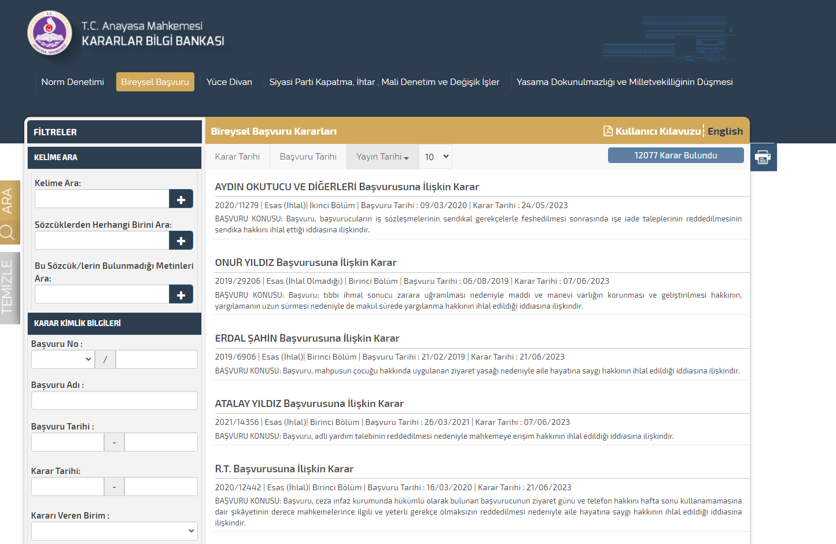
Dataset Source
The dataset consists of a total of 13,676 individual application decisions of the Turkish Constitutional Court.
The decisions were downloaded through the Turkish Constitutional Court's publicly available decision search engine.

Slide 10
Preprocessing Phase
The Turkish Constitutional Court evaluates individual applications according to whether or not they meet the admissibility requirements and examines the decisions decided to be admissible on the merits.
In the decisions it examines on the merits, it makes a decision on whether the right alleged to have been violated or not.
Since this study focuses on a binary classification problem, individual application decisions that are examined on the merits and find a violation are labeled as "violation", while other decisions are labeled as "no violation".

Slide 11
Preprocessing Phase
In order to limit the scope of the study, decisions that contain both violation and rejection decisions were excluded from the dataset, as in the study conducted by Mumcuoğlu et al. [1].
However, unlike the mentioned study, not all decisions with different outcomes were filtered out; instead, only decisions with different outcomes for the first two right types most relevant to the decision were removed.
After removal process, the final dataset created with 13,286 decision texts.

Slide 12
Exploratory Data Analysis
Label distrubition of dataset
Frequency of right types
Frequency of words
Distribution of number of words

Slide 13
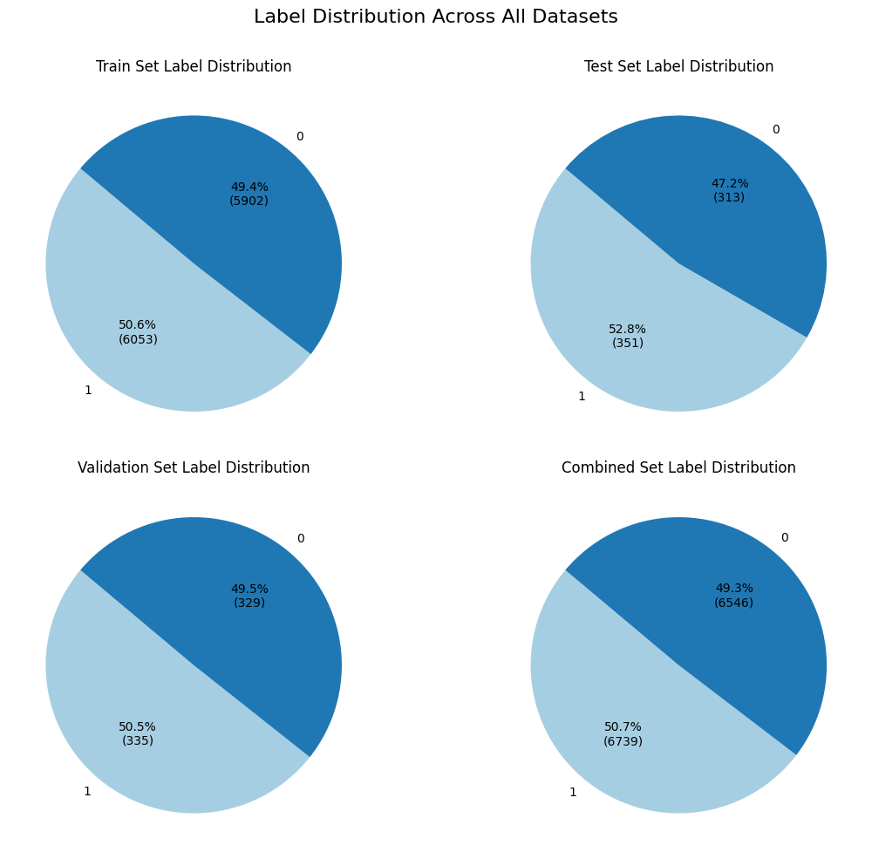
Distrubition of Dataset (EDA)

Slide 14
Distrubition of Dataset (EDA)

Slide 15
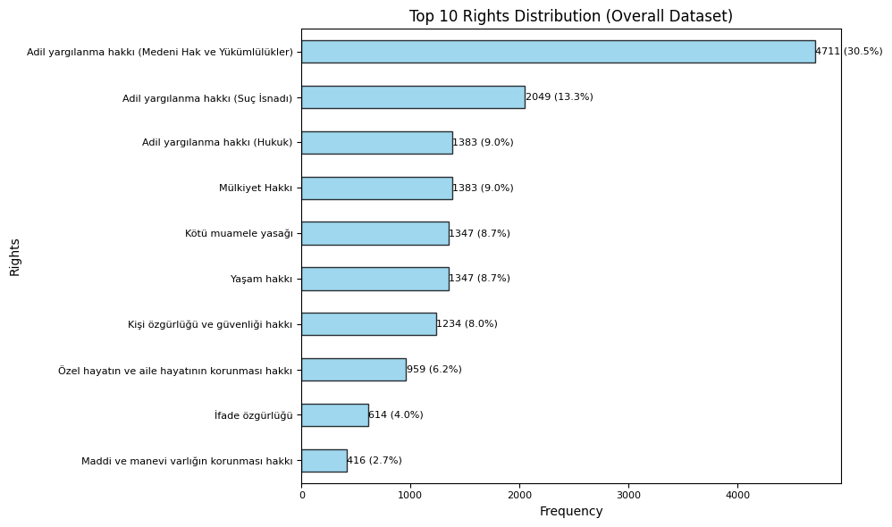
Frequency of Right Types (EDA)

Slide 16
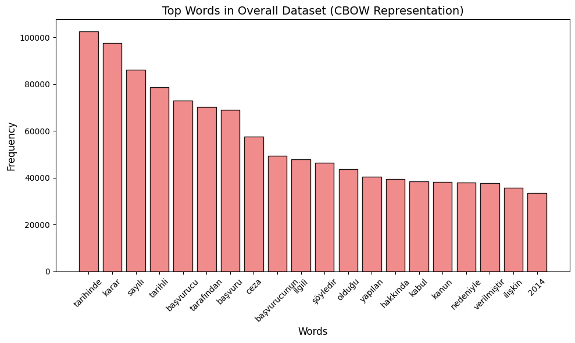

Slide 17
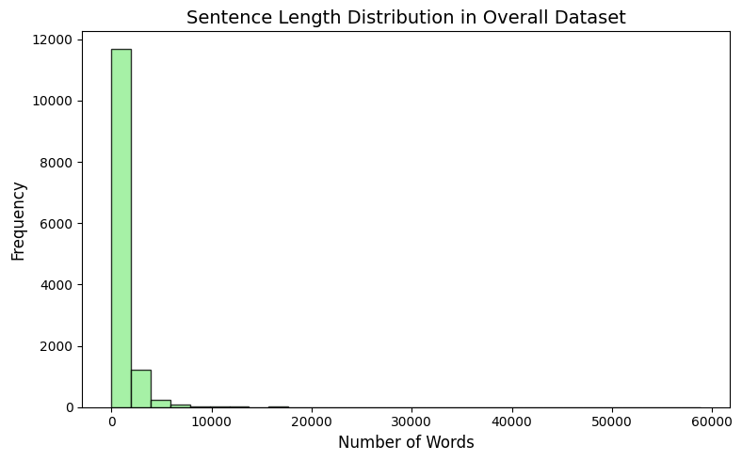

Slide 18
Methodology
Training with machine learning models
Training with deep learning models
Evaluation
Using explainability approachs to make results interpretable

Slide 19
Model Selection
- In this study, the architecture chosen as a reference for testing the explainability approach is the Transformer [12] architecture, which is known to achieve the best performance in many natural language processing tasks in the literature.
The models selected are encoder-only models known to have higher performance in supervised learning tasks such as text classification.
Also traditional ML algorithms like Decision Tree, Random Forest, Logistic Regression, Naive Bayes is used.

Slide 20
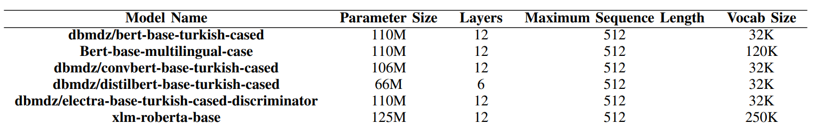
Architecture Details Of the DL Models
* Models are downloaded from Hugging Face platform. Only bert-base-turkish-cased model is selected to limit the scope of the project.

Slide 21
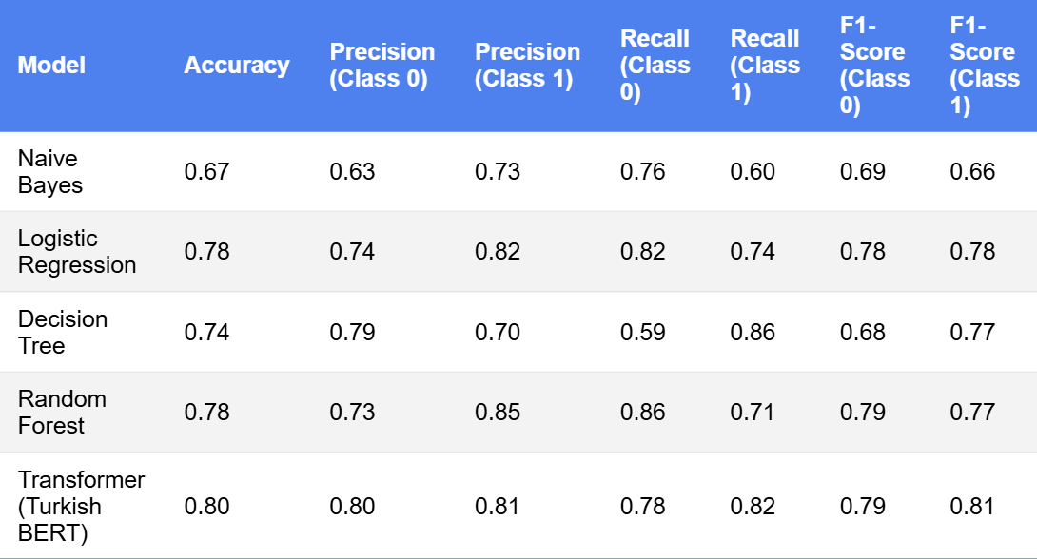
Experiment Results

Slide 22
Contribution to the Literature
The most significant contribution of the study presented in this paper is not only the achievement of models with high performance but also the development of an interdisciplinary approach toward the explainability of models.

Slide 23
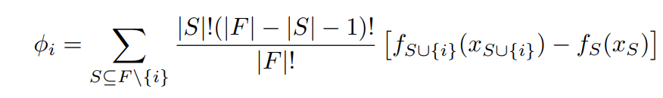
Calculating the SHAP Values
Shapley [13] values calculated with following formula:
It is practically not possible to find exact Shapley values. Therefore various methods implemented to approximate those values in SHAP [14] library. We have used Partition Explainer.
Number of coalitions without i
Number of coalitions after i
Total number
of coalitions
Marginal contrubition of player i to coalition S

Slide 24
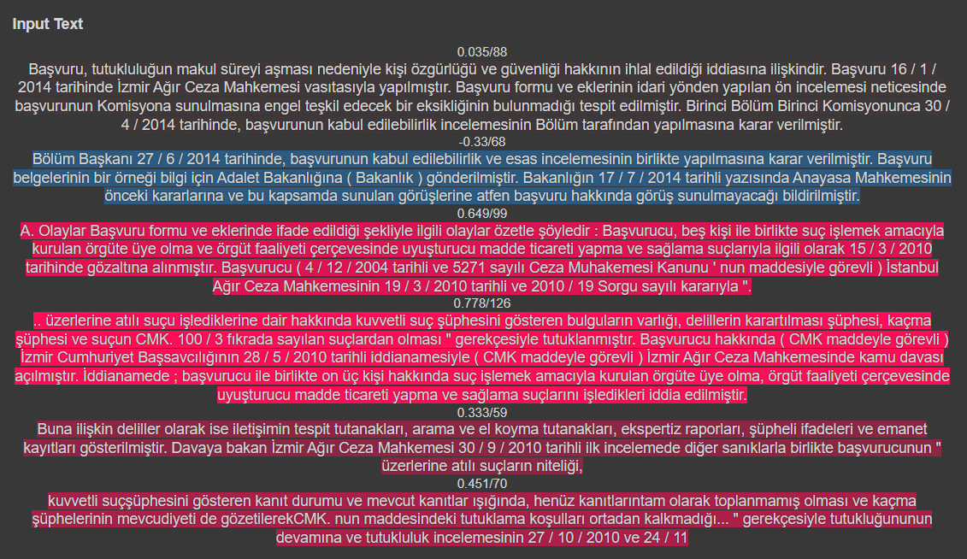
Example SHAP visualisation

Slide 25
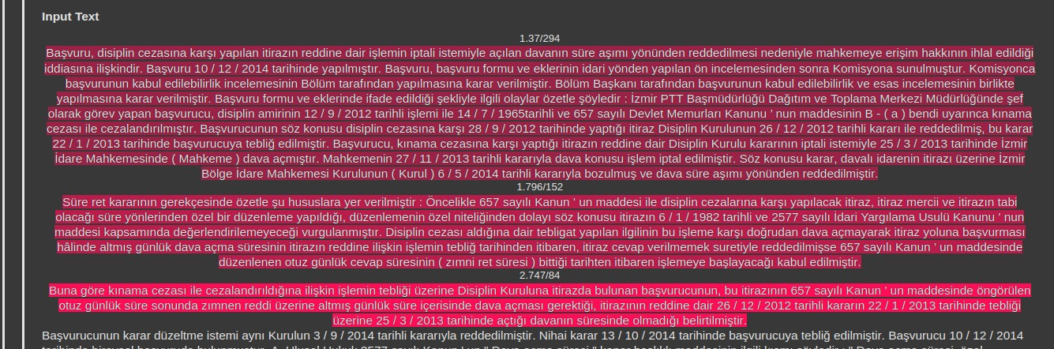
Example SHAP visualisation

Slide 26
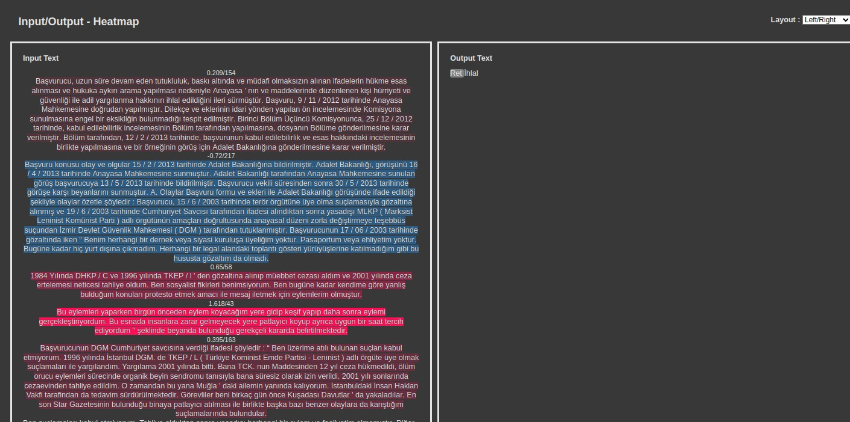
Example SHAP visualisation

Slide 27
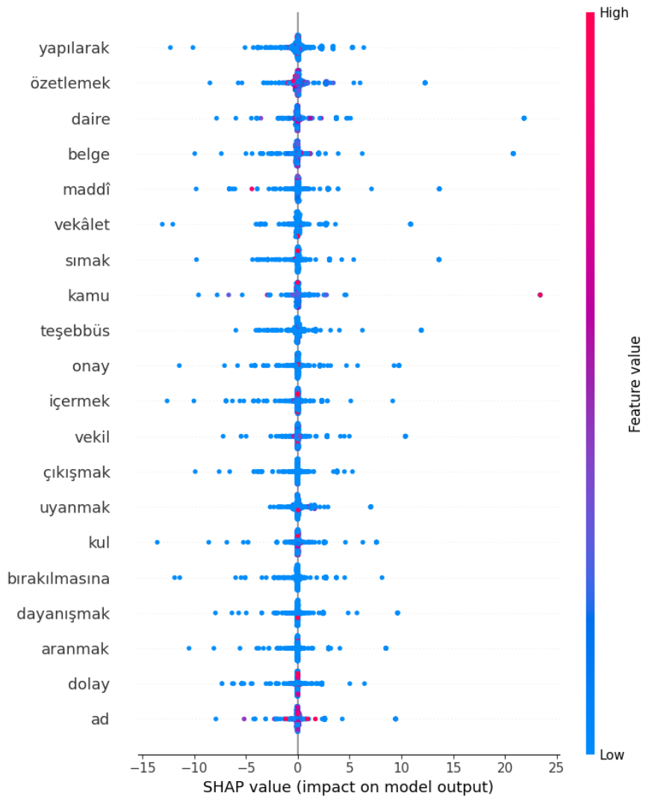
Example SHAP visualisation

Slide 28
Interesting Point
Another important point to emphasize in this study is the nature of the dataset. It is very difficult for a legal practitioner to predict the outcome of a constitutional court decision based only on the subject matter of the individual application and the concrete life event.

Slide 29
Conclusion
In conclusion, this study provides a foundational basis to guide future research in measuring and improving the explainability performance of AI models in the field of law.
The explainability approach presented in the paper is not the key that unlocks the black box completely, it merely provides ideas on how to build the key that social scientists and engineers will hold together.

Slide 30
References
1- E. Mumcuoglu, C. E. Öztürk, H. M. Ozaktas, and A. Koç, “Natural language processing in law: Prediction of outcomes in the higher courts of Turkey,” Information Processing & Management, vol. 58, no. 5, p. 102684, 2021.
2- A. C. Aras, C. E. Öztürk and A. Koç, "Feedforward Neural Network Based Case Prediction in Turkish Higher Courts," 2022 30th Signal Processing and Communications Applications Conference (SIU), Safranbolu, Turkey, 2022, pp. 1-4.
3- M. F. Sert, E. Yıldırım, and İ. Haşlak, “Using artificial intelligence to predict decisions of the Turkish Constitutional Court,” Social Science Computer Review, vol. 40, no. 6, pp. 1416–1435, 2021.
4- E. Aydemir, "Estimation of Turkish Constitutional Court Decisions in Terms of Admissibility with NLP," 2023 IV International Conference on Neural Networks and Neurotechnologies (NeuroNT), Saint Petersburg, Russian Federation, 2023, pp. 17-20.
5- O. Akça, G. Bayrak, A. M. Issifu and M. C. Ganiz, "Traditional Machine Learning and Deep Learning-based Text Classification for Turkish Law Documents using Transformers and Domain Adaptation," 2022 International Conference on INnovations in Intelligent SysTems and Applications (INISTA), Biarritz, France, 2022, pp. 1-6.

Slide 31
References
6- C. E. Öztürk, Ş. B. Özçelık and A. Koç, "Predicting Outcomes of the Court of Cassation of Turkey with Recurrent Neural Networks," 2022 30th Signal Processing and Communications Applications Conference (SIU), Safranbolu, Turkey, 2022, pp. 1-4.
7- M. B. L. Virtucio et al., "Predicting Decisions of the Philippine Supreme Court Using Natural Language Processing and Machine Learning," 2018 IEEE 42nd Annual Computer Software and Applications Conference (COMPSAC), Tokyo, Japan, 2018, pp. 130-135.
8- O.-M. ̧Sulea, M. Zampieri, M. Vela, and J. van Genabith, “Predicting the law area and decisions of French Supreme Court cases,” in Proceedings of the International Conference Recent Advances in Natural Language Processing, RANLP 2017, Varna, Bulgaria, Sep. 2017, pp. 716–722.
9- C. Erdoğanyımaz and B. Mengünoğul, "An Original Natural Language Processing Approach to Language Modeling in Turkish Legal Corpus: Improving Model Performance with Domain Classification by Using Recurrent Neural Networks," 2022 Innovations in Intelligent Systems and Applications Conference (ASYU), Antalya, Turkey, 2022, pp. 1-6.

Slide 32
References
10- Erdoğanyılmaz, C., Mengünoğul, B., & Balci, M. (2023, September). Unveiling the Black Box: Investigating the Interplay between AI Technologies, Explainability, and Legal Implications. In 2023 8th International Conference on Computer Science and Engineering (UBMK) (pp. 569-574). IEEE.
11- Turan, T., Küçüksille, E., & Alagöz, N. K. (2023). Prediction of Turkish Constitutional Court Decisions with Explainable Artificial Intelligence. Bilge International Journal of Science and Technology Research, 7(2), 128-141.
12- A. Vaswani et al., “Attention is all you need,” in Proc. 31st Int. Conf. Neural Inf. Process. Syst., 2017, pp. 6000–6010.
13- A. E. Roth, The Shapley Value: Essays in Honor of Lloyd S. Shapley. Cambridge, U.K.: Cambridge Univ. Press, 1988.
14- S. M. Lundberg and S. I. Lee, "A unified approach to interpreting model predictions," in Proc. Adv. Neural Inf. Process. Syst., 2017, pp. 4768–4777.

